Slide 1
Meet the Early Years Team

Slide 2
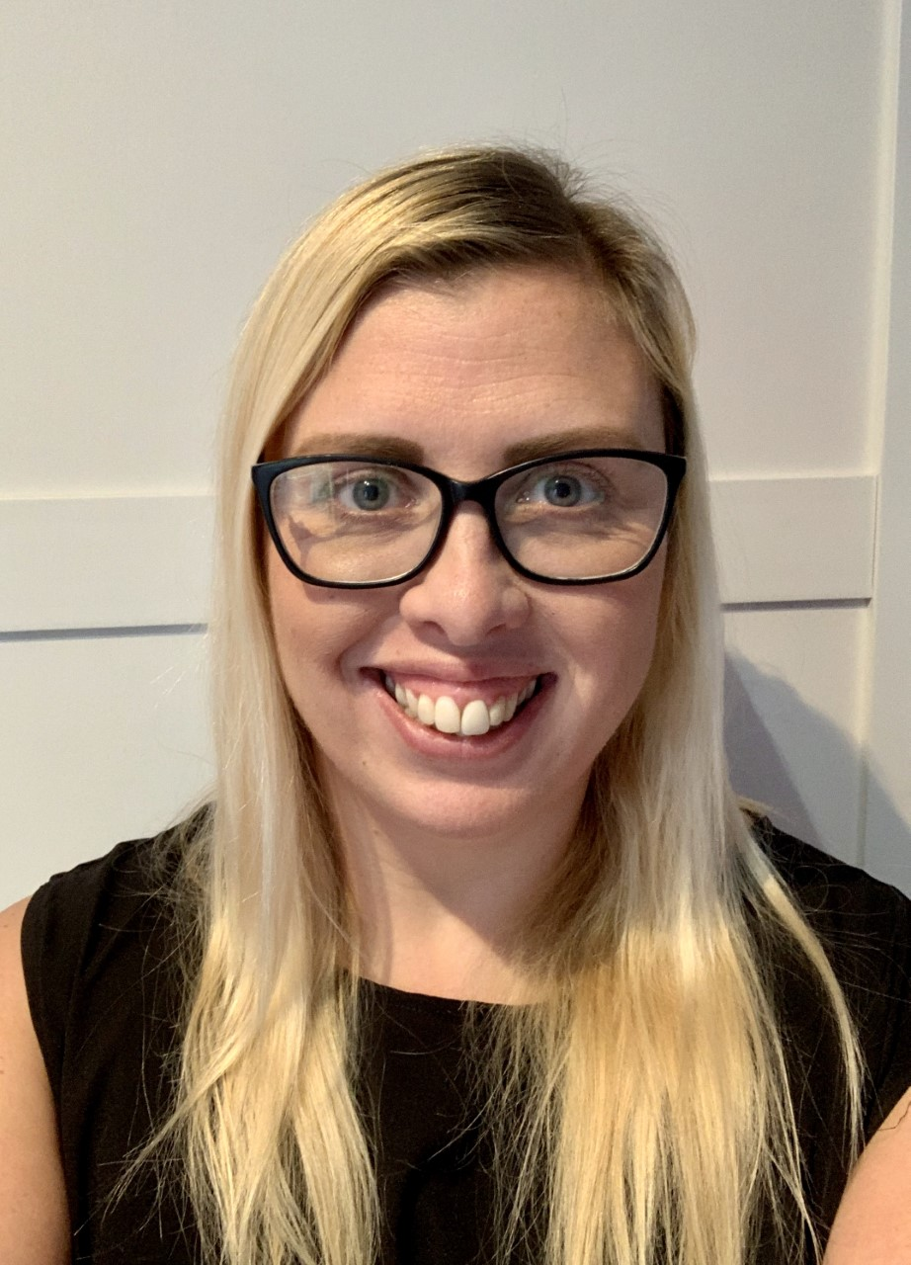
Mrs Murray
Hello, my name is Mrs Murray and I am so excited that you will be joining us soon at Mobberley Primary School. I have been a teacher at Mobberley Primary School for 13 years now which is a very long time. I love working here because we have so much fun at school each day. We are always busy playing, painting, making, running, dressing up, building and lots more!
I thought I would tell you a little bit about me. Firstly I am your teacher 3 days a week on a Monday, Tuesday and Wednesday. The rest of the week I am at home looking after my two daughters Maya who is 9 and Betsy who has just turned 3. We have just got a little puppy called Elsi. One of my favourite things to do is to go for long walks and explore new places. I also love to read, spend time in the garden and play games with my girls.
I am really looking forward to getting to know you all in September. I promise I will look after you and we will have lots of fun together.

Slide 3
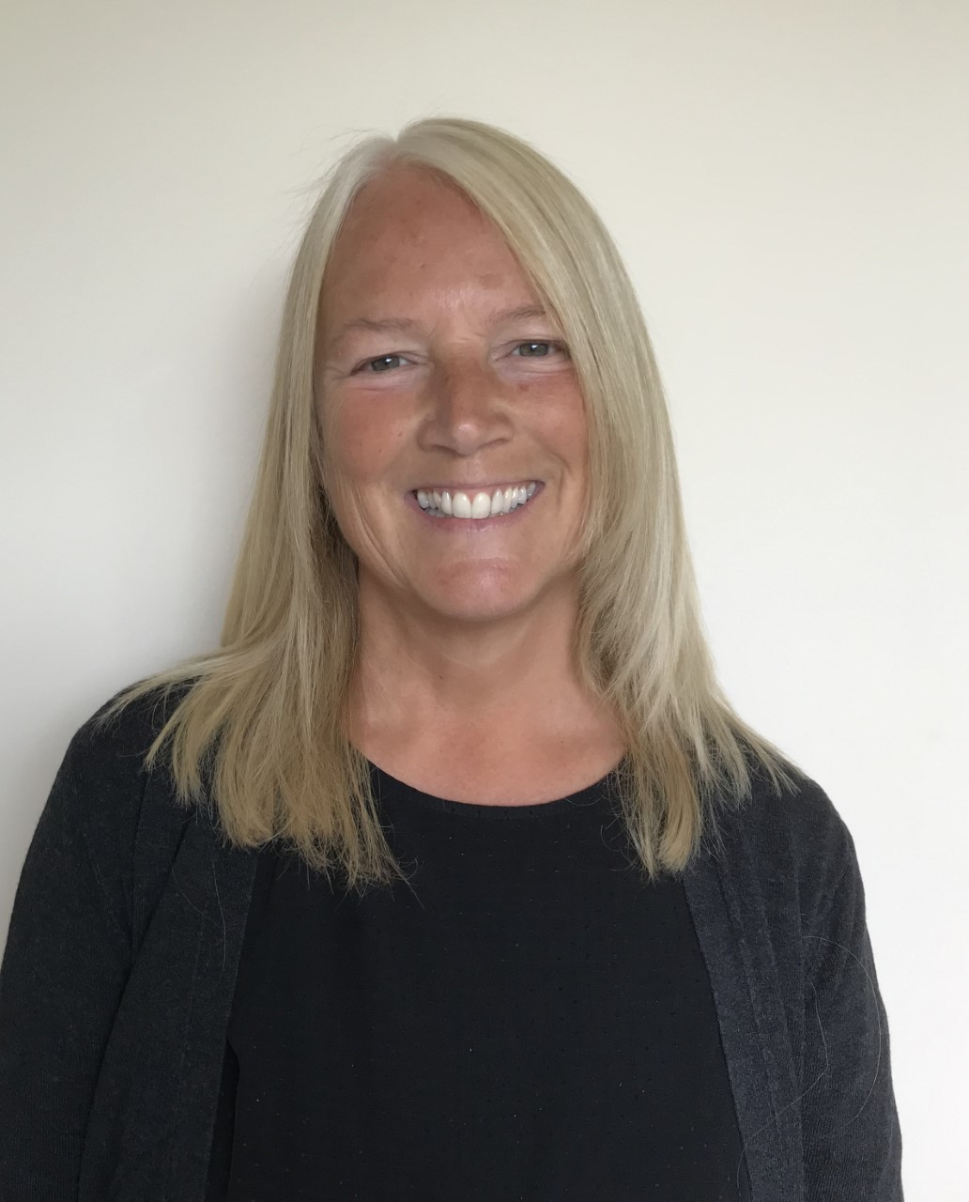
Mrs Franklin
Hello, my name is Mrs Franklin and I am really looking forward to meeting you all when you start in Reception Class, in September. I have been a teacher for over 30 years and I have been very lucky to teach at Mobberley CE Primary School for 12 years which I have thoroughly enjoyed, because we always have lots of fun and love learning new things together!
I am your teacher for 2 days a week on a Thursday and Friday. For the rest of the week I will be working in school in different classes. I have 2 grown up children, my daughter Nicola is 24 and my son Jack is 22 and they both work in London.
I love teaching, spending time and chatting away with my family, going on holiday, swimming, reading and going for walks.
I am so excited to meet you all and to have lots of wonderful times learning together in Reception Class throughout the school year ahead.

Slide 4
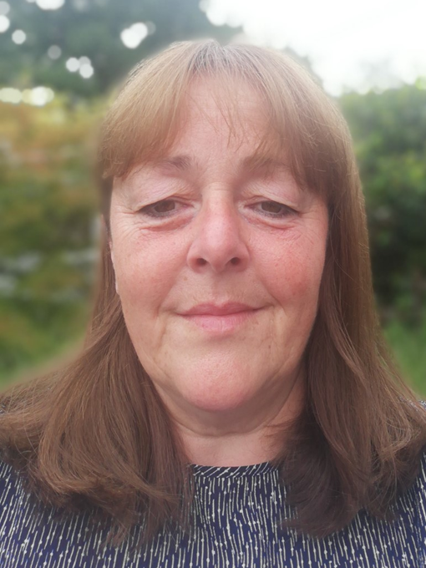
Mrs Norbury
Hi everyone, my name is Mrs Norbury and I am a teaching assistant in the Reception Class at Mobberley Primary School. I will be at school with Mrs Murray on a Monday, Tuesday and Wednesday.
I'm also here to help you with your lunch and I also help to run the after school club which we call MOPS!!
I have two daughters Amy and Lucy who both came to Mobberley Primary School and 4 Guinea Pigs. I love spending time in my garden and going on holiday in my caravan.
I hope you have a fantastic summer and am really looking forward to meeting you all.

Slide 5
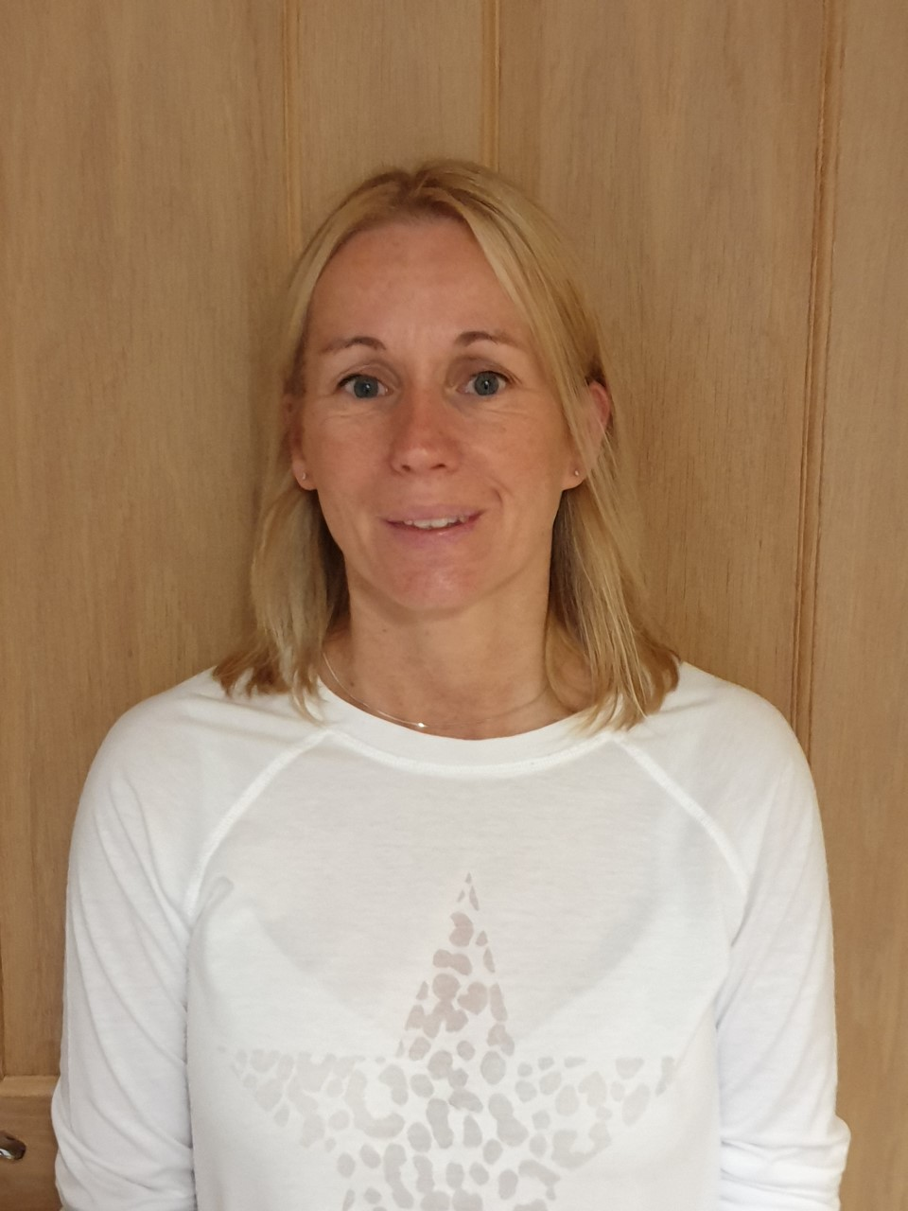
Mrs Ashworth
Hello, my name is Mrs Ashworth and I will be the Teaching Assistant in your class on Thursdays and Fridays.
I live in Mobberley with my family and my children Hannah and Ben, they went to Mobberley Primary School too. When I'm not at school I love baking, gardening and going on lovely walks with my little dog Bilbo.
I can't wait to see you all in September! Have a wonderful summer.

