Slide 1
Singfest 2024

Slide 2
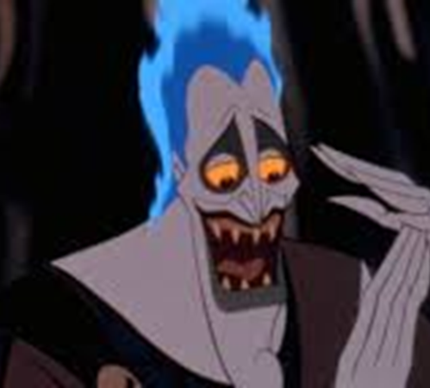
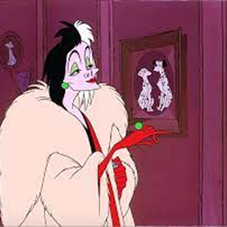
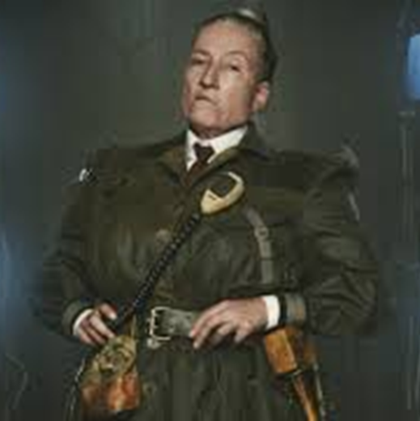
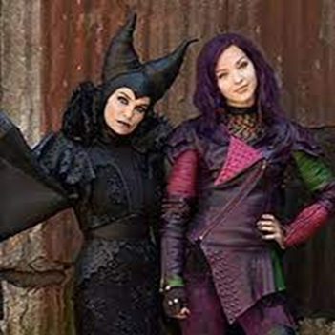
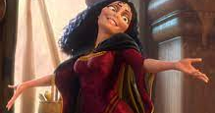
Villains
Double, Double
Be Prepared
Bad
Little Girls
Killer Queen
The Smell of Rebellion
Evil Like Me
Cruella de Vil
The Gospel Truth II
Poor Unfortunate Souls
Mother Knows Best
Gaston

Slide 3
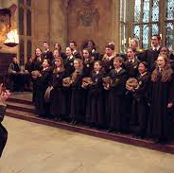
Double, Double, Toil and Trouble
Double, double toil and trouble, Fire burn, and cauldron bubble. Double, double toil and trouble, Something wicked this way comes!
Eye of newt, and toe of frog, Wool of bat, and tongue of dog, Adder's fork, and blind-worm's sting, Lizard's leg, and owlet's wing.
Double, double toil and trouble, Fire burn, and cauldron bubble. Double, double toil and trouble, Something wicked this way comes!

Slide 4
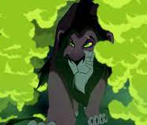
Be Prepared
I know that your powers of retention Are as wet as a warthog's backside. But thick as you are, pay attention, My words are a matter of pride.
It's clear from your vacant expressions The lights are not all on upstairs. But we're talking kings and successions. Even you can't be caught unawares!
So prepare for a chance of a lifetime. Be prepared for sensational news. A shining new era, is tiptoeing nearer.
And where do we feature? Just listen to teacher!
I know it sounds sordid, but you'll be rewarded, when at last I am given my dues. And injustice deliciously squared.
Be prepared!

Slide 5
BAD
Echo:
Bad, bad, really really bad
Bad, bad ,really really bad
Because I’m bad, I’m bad, come on!
You know I’m bad, I’m bad, you know it!
You know I’m bad, I’m bad, come on, you know.
And the whole world has to answer right now
just tell you once again
‘Who’s bad?’

Slide 6
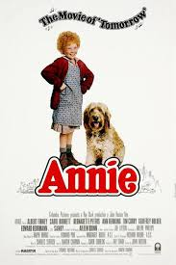
Little girls
Little cheeks, little teeth,
Everything around me is little. If I wring, little necks, surely I will get an acquittal? Some women are dripping with diamonds, Some women are dripping with pearls.
Lucky me, lucky me, look at what I'm dripping with…..little girls!
How I hate little shoes, little socks, and each little bloomer. I'd have cracked years ago, if it weren't for my sense of humour! Some day, I'll step on their freckles, Some night, I'll straighten their curls! Send a flood, send the flu, anything that you can do
To little girls!

Slide 7
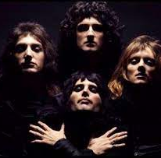
Killer Queen
He keeps her Moët et Chandon In her pretty cabinet. "Let them eat cake, " she says Just like Marie Antoinette. A built-in remedy, for Khrushchev and Kennedy. At anytime an invitation, you can't decline.
Caviar and pirouettes,
Well versed in etiquette, Extraordinarily nice!
She's a Killer Queen, gunpowder, gelatine Dynamite with a laser beam. Guaranteed to blow your mind Anytime!
Recommended at the price, Insatiable an appetite Wanna try?

Slide 8
The Smell of Rebellion
Discipline, discipline, For children who aren't listening. For midgets who are fidgeting And whispering in history. Their chattering and chittering, Their nattering and twittering Is tempered with a smattering of Discipline!
The simpering and whimpering, The dribbling and the spittling The ‘Miss, I need a tissue’ Is an issue we can fix. There is no mystery to mastering The art of classroom mistressing. It's discipline, discipline, discipline!
The smell of rebellion! The stench of revolt! The reek of pre-pubescent plotting! The whiff of resistance! The pong of dissent! The stink of moral fibre rotting!

Slide 9
Evil like me
Don't you wanna be evil like me? Don't you wanna be mean? Don't you wanna make mischief your daily routine? Well, you can spend your life attending to the poor But when you're evil doing less is doing more! Don't you wanna be ruthless and rotten and mad? Don't you wanna be very, very good at being bad?
This is not for us to ponder, this was preordained. You and I shall rule together, freedom soon regain. Mistress of the universe, powerful and strong.
Daughter, hear me, help me, join me, Won't you sing along?

Slide 10
Yeah, we're gonna be evil, it's true! Never gonna think twice! And we're gonna be spiteful! (yes spiteful) That's nice!
In just an hour or two, our future's safe and sure. This mother, daughter act is going out on tour!
If you wanna be evil, and awful, and free, Then you should thank your lucky star, That you were born the girl you are. The daughter of an evilicious queen Like me!

Slide 11
Cruella De Vil, Cruella De Vil. If she doesn't scare you, no evil thing will! To see her is to take a sudden chill. Cruella, Cruella De Vil.
The curl of her lips, the ice in her stare. All innocent children, had better beware. She's like a spider waiting for the kill. Look out for Cruella De Vil!
At first you think, Cruella is the devil. But after time has worn away the shock, You come to realise,
You've seen her kind of eyes Watching you from underneath a rock!
This vampire bat, this inhuman beast. She ought to be locked up and never released. The world was such a wholesome place until Cruella, Cruella De Vil!
Repeat whole thing!

Slide 12
The Gospel Truth II
He ran the underworld.
But thought the dead, were dead and uncouth.
He was as mean as he was ruthless.
And that’s the gospel truth.
He had a plan to shake things up.
And that’s the gospel truth

Slide 13
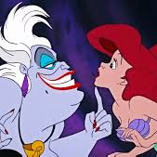
Poor Unfortunate soul
Poor unfortunate souls, in pain, in need.
This one longing to be thinner, that one wants to get the girl.
And do I help them? Yes indeed!
Those poor unfortunate souls, so sad, so true.
They come flocking to my cauldron,
Crying ‘’Spells, Ursula, please‘’, and I help them?
Yes I do!
Now is happened once or twice someone couldn’t pay the price and I’m afraid I had to rake them ‘cross the coals.
Yes I’ve had the odd complaint, but on the whole I’ve been a saint…..to those poor unfortunate souls!

Slide 14
Mother knows best, take it from your Mumsy On your own, you won't survive. Sloppy, underdressed, immature, clumsy Please, they'll eat you up alive. Gullible, naive, positively grubby, Ditzy and a bit, well, hmm, vague. Plus, I believe gettin' kinda frumpy, I'm just saying 'cause I wuv you. Mother understands, mother's here to help you., All I have is one request.
Soloists dialogue: Rapunzel:Yes? MG: Don't ever ask to leave this tower again
Rapunzel:Yes, mother MG: I love you very much, dear
Rapunzel: I love you more MG: I love you most
Don't forget it, you'll regret it! Mother knows best!

Slide 15
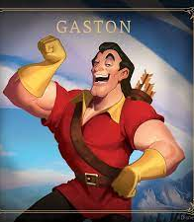
GASTON
No one's slick as Gaston, No one's quick as Gaston, No one's neck's as incredibly thick as Gaston!
For there's no man in town half as manly. Perfect, a pure paragon. You can ask any Tom, Dick or Stanley, And they'll tell you whose team they prefer to be on.
Who plays darts like Gaston? Who breaks hearts like Gaston?
Who’s much more than the sum of his parts like Gaston?
(Solo: As a specimen, yes, I’m intimidating)
My what a guy that Gaston!
…..

Slide 16
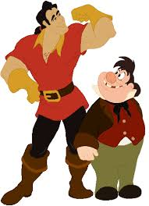
No one hits like Gaston, matches wits like Gaston.
In a spitting match nobody spits like Gaston!
(I’m especially good at expectorating )
Ten points for Gaston!
…..
Who has brains likes Gaston, entertains like Gaston?
Who can make up these endless refrains like Gaston?
(Solo: I use antlers in all my decorating.)
Say it again! Who’s a man among men?
Who’s the super success? Don’t you know? Can’t you guess?
Ask his fans and his five hangers on.
There’s just one guy in town, who’d got all of it down
…..
GASTON!

Slide 17
Zero to Hero
One Call Away
Holding out for a Hero
A Whole New World
Hakuna Matata
Superheroes
Something Just Like This
Friend Like Me
Prince Ali
Spiderman

Slide 18
Bless my soul Herc was on a roll, Person of the week in every Greek opinion poll. What a pro Herc could stop a show! Point him at a monster and you're talking SRO, He was a no one, a zero, zero. Now he's a honcho, he's a hero! Here was a kid with his act down pat, From zero to hero in no time flat. Zero to hero just like that!
When he smiled the girls went wild with ‘oohs and aahs’! And they slapped his face on every vase (on every vahse).
From appearance fees and royalties Our Herc had cash to burn. Now nouveau riche and famous He could tell you what's a Grecian urn!

Slide 19
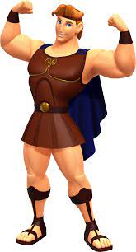
Say Amen there he goes again, Sweet and undefeated and an awesome ten for ten. Folks lined up just to watch him flex And this perfect package packed a pair of pretty pecs. Hercie, he comes, he sees, he conquers. Honey, the crowds were going bonkers! He showed the moxie brains, and spunk. From zero to hero a major hunk. Zero to hero and who’d a thunk?
Who put the glad in gladiator? (Hercules.) Whose daring deeds are great theater? (Hercules.) Isn't he bold? (No one braver!) Is he sweet? (Our favourite flavour!) Hercules, Hercules, Hercules, Hercules, Hercules, Hercules.
Bless my soul Herc was on a roll, undefeated! Riding high and the nicest guy, not conceited.
He was a nothin’, a zero, zero. Now he's a honcho, he's a hero! He hit the heights at breakneck speed. From zero to hero, Herc is a hero! Now he's a herooooooooooo, Yes indeed!

Slide 20
One call away
When you're weak I'll be strong, I'm gonna keep holding on.
Now don't you worry, it won't be long. And when you you feel like hope is gone, Just run into my arms. I'm only one call away, I'll be there to save the day. Superman got nothing on me. I'm only one,
I'm only one,
One call away……
I'm only one call away, I'll be there to save the day. Superman got nothing on me. I'm only one call away.
Call me, baby, if you need a friend. I just wanna give you love. C'mon, c'mon, c’mon, Reaching out to you, so take a chance.
No matter where you go, you know you're not alone.
I'm only one call away……..

Slide 21
Holding out for A Hero
Doo doo doo dooo, doo doo doo doo, doo doo doo doo, aah aah!
Where have all the good men gone And where are all the gods? Where's the streetwise Hercules To fight the rising odds?
Isn't there a white knight upon a fiery steed? Late at night, I toss and I turn And I dream of what I need.
I need a hero! I'm holding out for a hero 'til the end of the night. He's gotta be strong, and he's gotta be fast And he's gotta be fresh from the fight.
I need a hero! I'm holding out for a hero 'til the morning light. He's gotta be sure, and it's gotta be soon And he's gotta be larger than life (larger than life)!

Slide 22
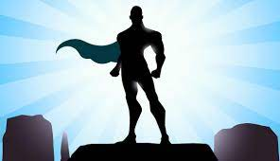
Doo doo doo dooo, doo doo doo doo, doo doo doo doo, aah aah!
Up where the mountains meet the heavens above, Out where the lightning splits the sea, I could swear there is somebody there, someone watching me!
Through the wind and the chill and the rain And the storm and the flood,
I can feel his approach like a fire in my blood. Like a fire in my blood, like a fire in my blood Like a fire in my blood, like a fire in my, ‘Aah aah!’
I need a hero! I'm holding out for a hero 'til the end of the night. He's gotta be strong, and he's gotta be fast And he's gotta be fresh from the fight.
I need a hero! I'm holding out for a hero 'til the morning light. He's gotta be sure, and it's gotta be soon And he's gotta be larger than life (larger than life)!
Doo doo doo dooo, doo doo doo doo, doo doo doo doo, aah aah!
I need a hero!

Slide 23
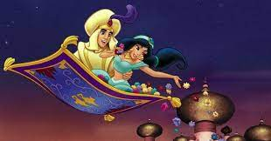
I can show you the world, Shining, shimmering, splendid. Tell me, princess, now when did You last let your heart decide?
I can open your eyes, Take you wonder by wonder. Over, sideways and under On a magic carpet ride.
A whole new world, A new fantastic point of view. No one to tell us no or where to go Or say we're only dreaming.
A whole new world, A dazzling place I never knew. But when I'm way up here it's crystal clear That now I'm in a whole new world with you.
Unbelievable sights, Indescribable feeling. Soaring, tumbling, freewheeling Through an endless diamond sky.
A whole new world,
A hundred thousand things to see.
I'm like a shooting star, I've come so far, I can’t go back.
I’m in a whole new world, with new horizons to pursue.
I’ll chase them anywhere,
There’s time to spare.
Let me share this whole new world with you.
A whole new world,
That’s where we’ll be.
A thrilling chase, a wond’rous place,
For you and me.

Slide 24
It means no worries, for the rest of your days.
It’s our problem free philosophy.
Hakuna Matata!
Hakuna Matata - what a wonderful phrase!
Hakuna Matata, ain’t no passing craze.
It means no worries, for the rest of your days.
It’s our problem free, philosophy.
Hakuna Matata!
Hakuna Matata, Hakuna Matata, Hakuna Matata!
Hakuna Matata - what a wonderful phrase!
Hakuna Matata, ain’t no passing craze.
It means no worries, for the rest of your days.
It’s our problem free philosophy.
Hakuna Matata!
Spoken:
Hakuna Matata! What a wonderful phrase! …..
Hakuna Matata! Ain’t no passing craze. ……

Slide 25
All her life she has seen All the meaner side of mean. They took away the prophet's dream For a profit on the street.
Now she's stronger than you know, A heart of steel starts to grow.
All his life he's been told He'll be nothing when he's old. All the kicks and all the blows, He won't ever let it show.
'Cause he's stronger than you know; A heart of steel starts to grow
When you've been fighting for it all your life, You've been struggling to make things right, That's how a superhero learns to fly. (Every day, every hour, turn their pain into power.)
When you've fighting for it all your life, You've been working every day and night. That's how a superhero learns to fly. (Every day, every hour, turn their pain into power.)
Every day, every hour, turn their pain into power.
(Every day, every hour, turn their pain into power.)
When you've been fighting for it all your life,
You've been struggling to make things right, That's how a superhero learns to fly.

Slide 26
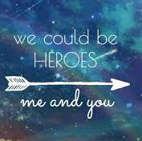
We go hide away in daylight. We go undercover, out in the sun. Got a secret side in plain sight. Where the streets are empty, that's where we run
Ev’ry day people do everyday things,
But I can't be one of them. I know you hear me now, we are a different kind, We can do anything.
We could be heroes, ooh ooh ooh ooh. We could be heroes, me and you. We could be…..
All we're looking for is love and a little light, Love and a little light. We could be…. All we're looking for is love and a little light, Love and a little light.
We could be heroes, ooh ooh ooh ooh. We could be heroes, me and you. We could be…..

Slide 27
Something just like this
I’ve been reading books of old, The legends and the myths. Achilles and his gold, Hercules and his gifts. Spiderman's control And Batman with his fists. And clearly I don't see myself upon that list.
She said, ‘Where d’you wanna go?’
‘How much you wanna risk?’ I'm not lookin' for somebody With some superhuman gifts. Some superhero, some fairy-tale bliss, Just something I can turn to, Somebody I can kiss.
I want something just like this, Doo-doo-doo…….
Oh, I want something just like this, Doo-doo-doo..
Oh, I want something just like this.
I want something just like this
I've been reading books of old, The legends and the myths. The testaments they told, The moon and its eclipse.
Superman unrolls A suit before he lifts. But I'm not the kind of person that it fits.
She said, ‘Where d’you wanna go?’ ‘How much you wanna risk?’ I'm not lookin' for somebody With some superhuman gifts.
Some superhero, some fairy-tale bliss, Just something I can turn to, Somebody I can kiss.
I want something just like this
I want something just like this

Slide 28
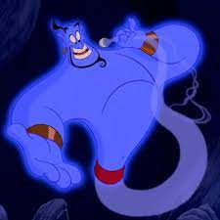
Well, Ali Baba had them forty thieves,
Scheherazade had a thousand tales, But master, you in luck 'cause up your sleeve You got a brand of magic never fails!
You got some power in your corner now,
Some heavy ammunition in your camp. You got some punch, pizzazz, yahoo and how? See, all you gotta do is rub that lamp, and I'll say,
"Mister Aladdin, sir, what will your pleasure be?" Let me take your order, jot it down, You ain't never had a friend like me, no no no! Life is your restaurant and I'm your maitre d’, Come on, whisper what it is you want, you ain't never had a friend like me!

Slide 29
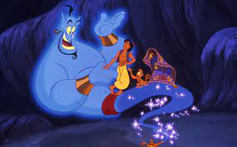
Yes sir, we pride ourselves on service.
You're the boss, the king, the shah! Say what you wish, it's yours, true dish.
How 'bout a little more baklava?
Have some of column A, try all of column B.
I'm in the mood to help you, dude.
You ain't never had a friend
(never had a friend, you ain’t never had a friend, never had a friend)
You ain’t never had a friend like me!
(Wah wah wah, wah wah )
Wah wah wah
Oh my, you ain’t ever had a friend like me! Ha!

Slide 30
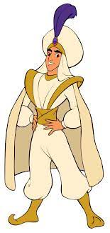
Prince Ali
Prince Ali, fabulous he, Ali Ababwa! Genuflect, show some respect, down on one knee! Now, try your best to stay calm, Brush up your Sunday salaam. Then come and meet his spectacular coterie
Prince Ali, mighty is he, Ali Ababwa!
Strong as ten regular men
Definitely
He's faced the galloping hordes
A hundred bad guys with swords
Who sent those goons to their lords?
Why, Prince Ali
He's got 75 golden camels!
Purple peacocks, he's got 53! When it comes to exotic-type mammals He's got a zoo?
I'm telling you,
It's a world-class menagerie!

Slide 31
Prince Ali
Prince Ali, fabulous he, Ali Ababwa! Genuflect, show some respect, down on one knee! Now, try your best to stay calm, Brush up your Sunday salaam. Then come and meet his spectacular coterie!
Make way for Prince Ali!

Slide 32
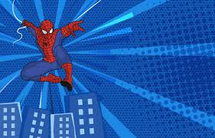
c
Spiderman, Spiderman, does whatever a spider can! Spins a web, any size, catches thieves just like flies! Look out!! Here comes the Spiderman!
In the chill of night, at the scene of a crime, Like a streak of light, he arrives just in time.
Spiderman, Spiderman,
Friendly neighbourhood Spiderman. Wealth and fame, he's ignored. Action is his reward!
To him, life is a great big bang up,
Whenever there’s a hang up,
You’ll find the Spiderman!

