Slide 1
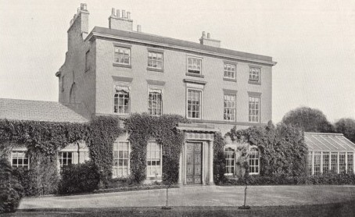
Charles Darwin was born in this house, The Mount, near Shrewsbury, Shropshire, England on 12 February 1809. He was the son of Robert Waring Darwin and Susannah Wedgwood.

Slide 2
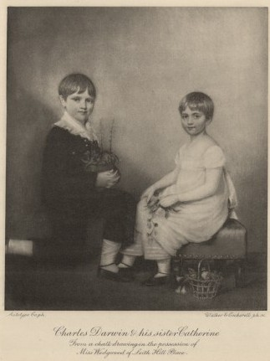
Darwin (aged 9) with his sister Catherine. He had three other sisters: Marianne, Caroline and Susan; as well as a brother named Erasmus.

Slide 3
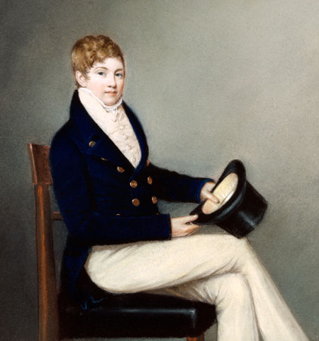
Erasmus was his best friend; they even set up a chemical lab in their garden shed which earned him the nickname ‘gas’ from the smelly experiments they did!

Slide 4
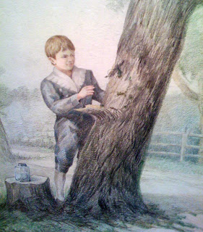
Darwin enjoyed shooting as a teenager with his Uncle Jos. He also liked going for walks, bird watching and collecting beetles – amongst other things.

Slide 5
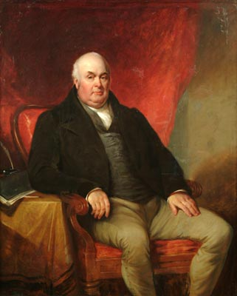
Charles Darwin’s father (Robert Darwin) was a doctor. They were a wealthy family. Sadly, Charles’s mother passed away in 1817.

Slide 6
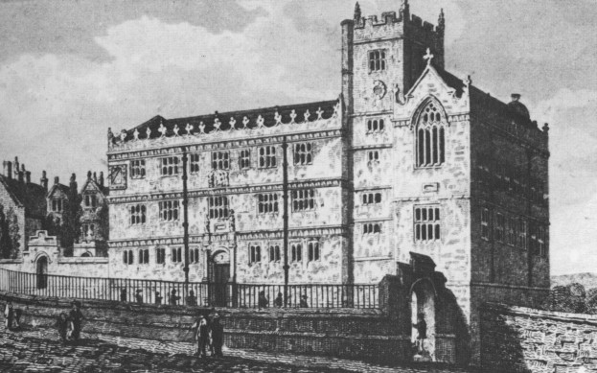
Darwin attended Shrewsbury Free Grammar School as a boarder from 1818-1825. Charles loved nature but hated school – particularly Latin and Greek which he was expected to learn by heart.

Slide 7
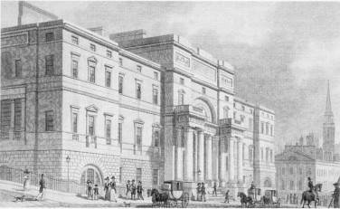
Darwin’s father was a doctor and wanted Charles to study medicine too so sent him to Edinburgh university (1825 – 1827) to study however Charles later discovered he was afraid of blood!

Slide 8
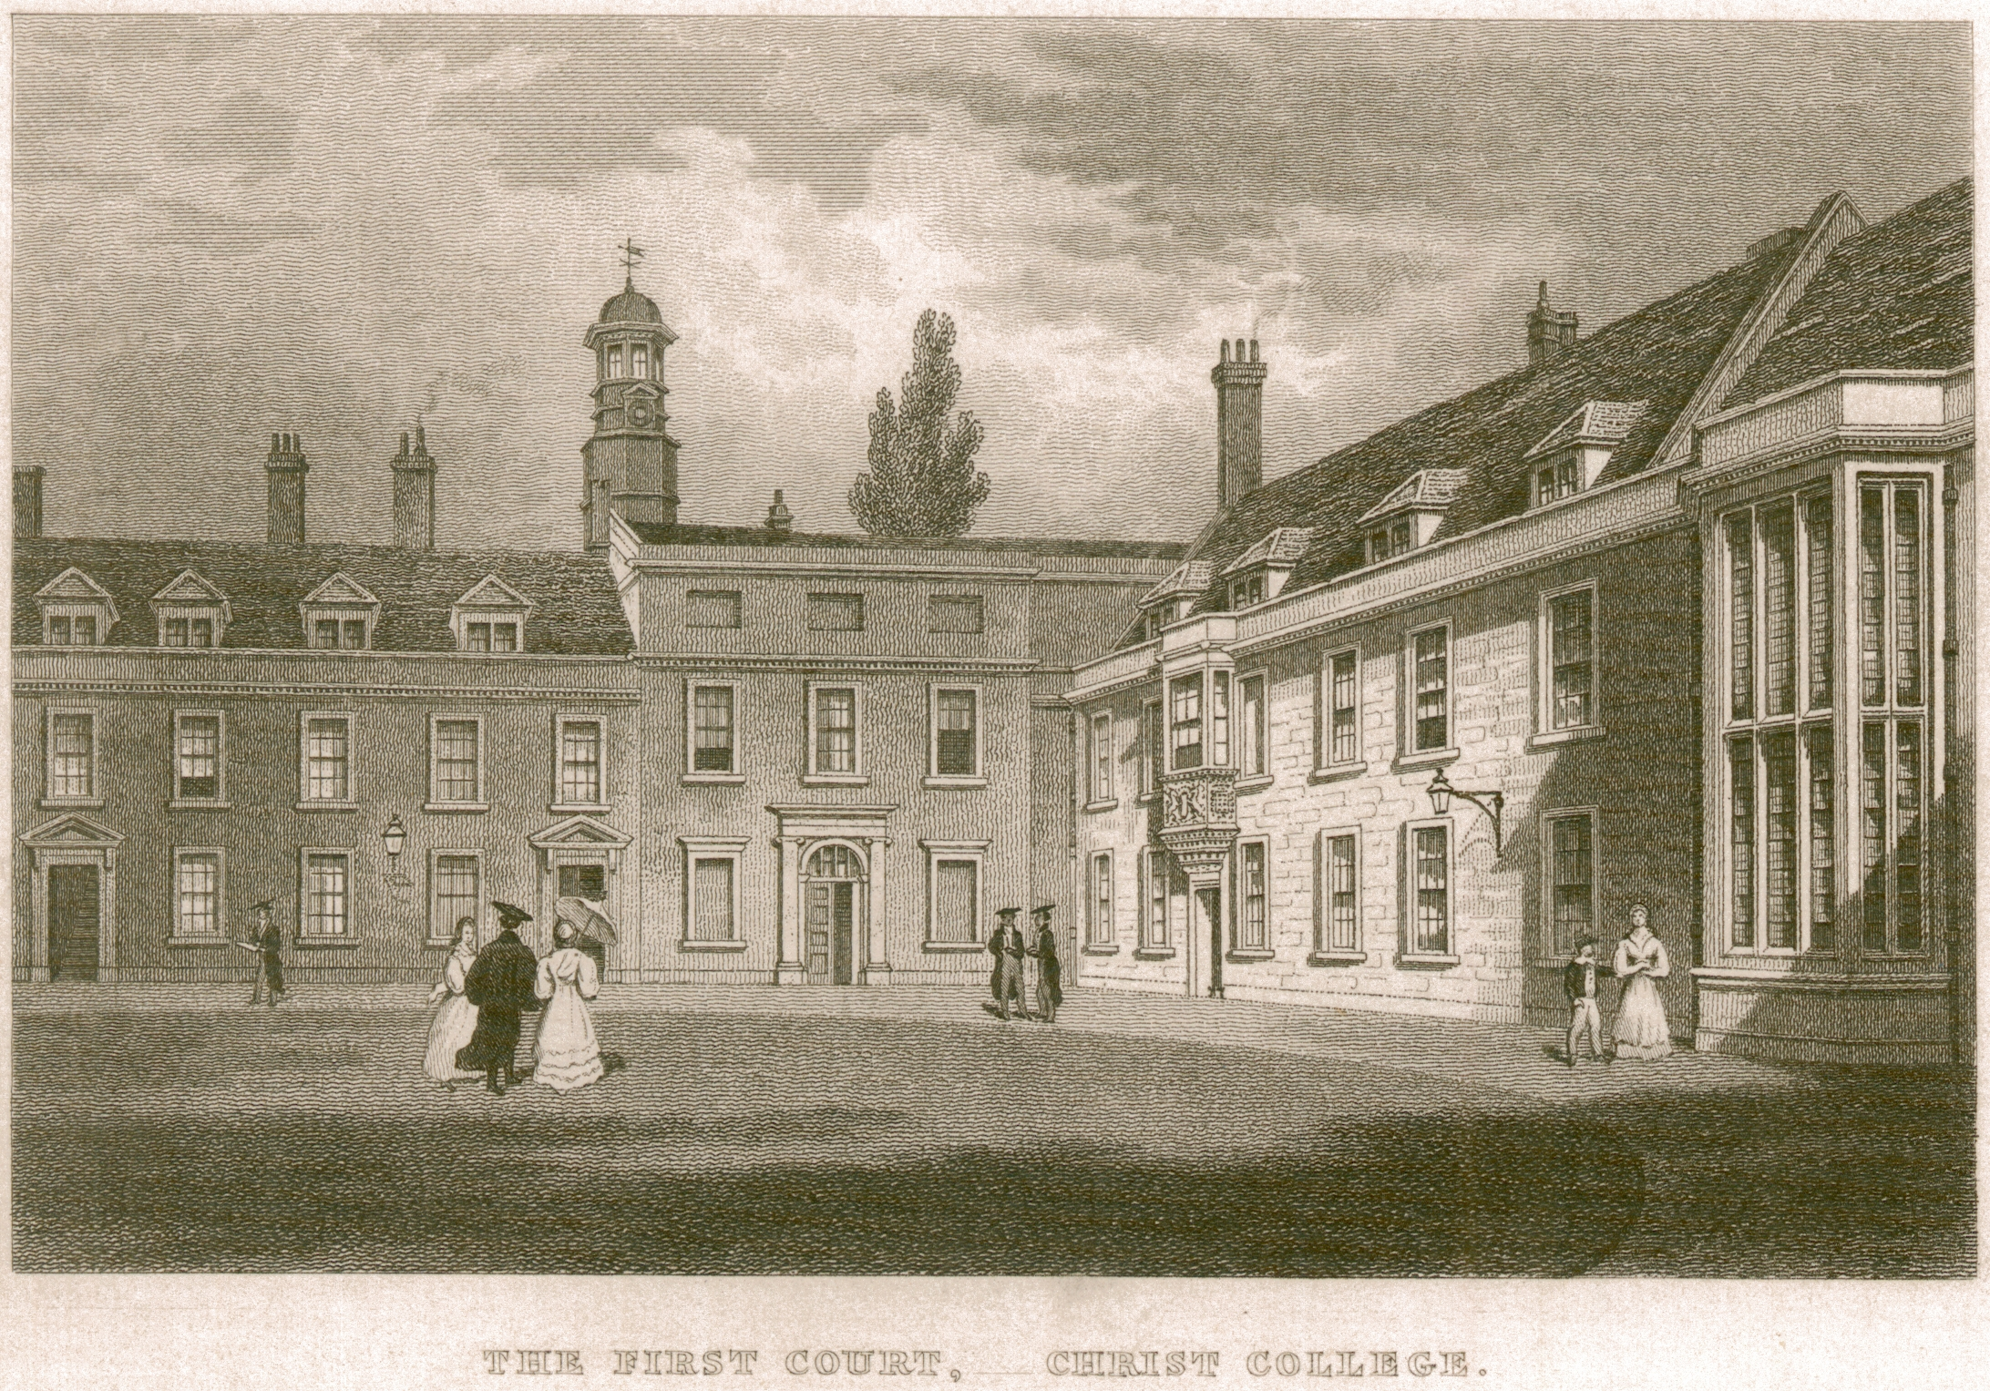
His Dad later suggested that he became a priest so he went to Christ’s College at Cambridge University but did not like that either! He had doubts over his faith and so wasn’t committed to his degree learning.

Slide 9
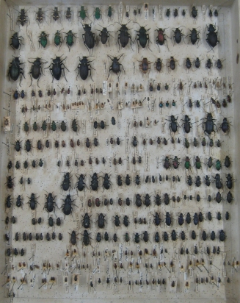
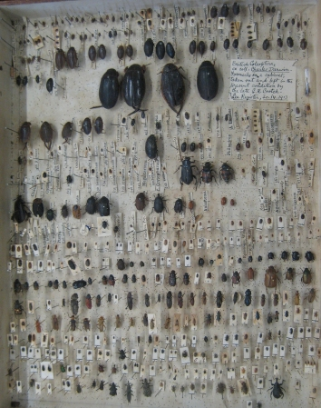
Darwin was an avid collector of beetles while at Cambridge.

Slide 10
During his time at Cambridge he realised his passion for geology (rocks) and botany (plants). He met Professor Henslow and Professor Sedgwick who helped him to study. Darwin ranked 10th out of 178 people in his final exams!

Slide 11
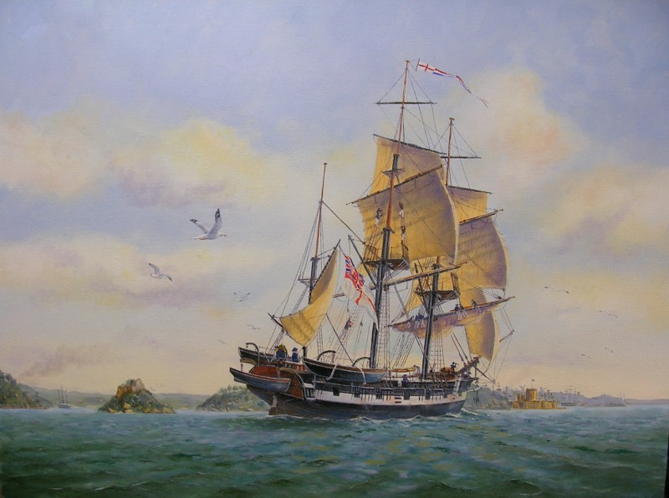
In 1831, aged 22, Henslow offered Darwin a 5 year voyage on the HMS Beagle (a naval survey ship) which was responsible for mapping coastlines. Darwin wanted to collect evidence and carry out detailed research.

Slide 12
He was stunned by how small the vessel was however it did have a library! He slept in a hammock and was often sea sick for days at a time.

Slide 13
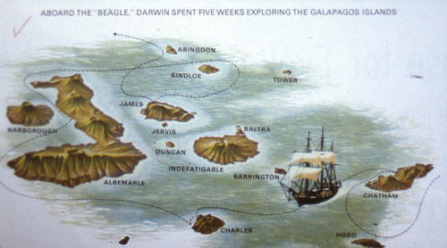
On the voyage he visited many countries including: Brazil, Chile, Australia, Falkland Islands, South Africa and the Galapagos Islands (where he spent most of his time).

Slide 14
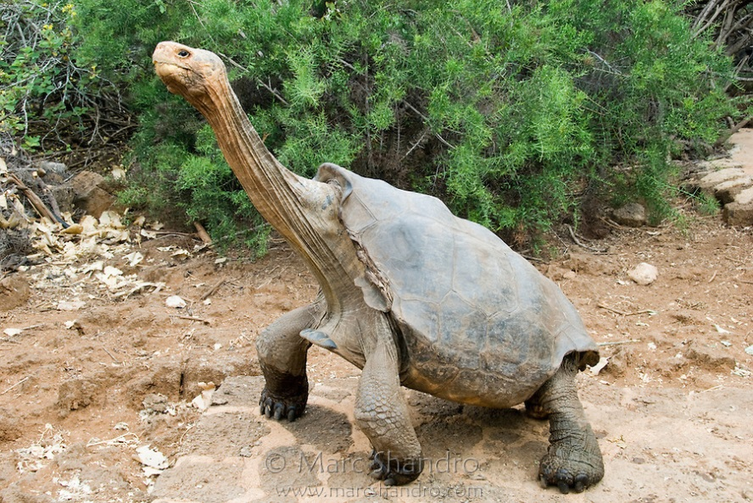
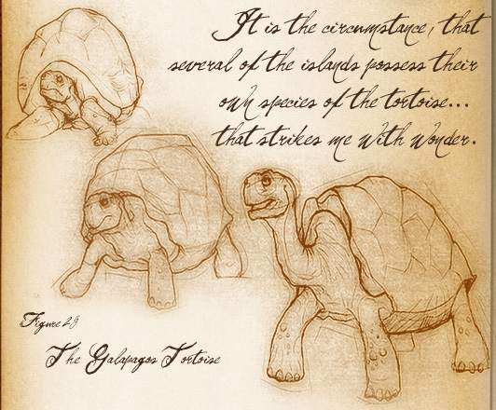
Whilst on the Galapagos Islands, Darwin and his men saw giant Galapagos tortoises. During their trip they rode them like horses and shot 18 of them to use as meat. It wasn’t until much later that Darwin recognised their importance in his work with natural selection.

Slide 15
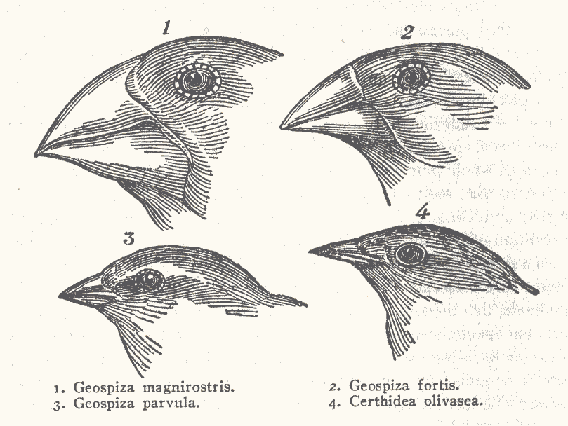
One of his most well known theories – that of natural selection – was prompted by his discovery that each of the Galapagos Islands supported Finches with different beaks, adapted to the habitats and food sources available.

Slide 16
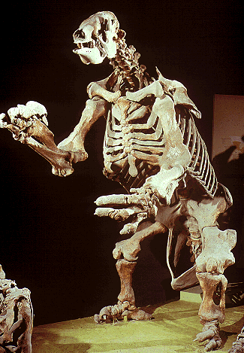
During his time on the Galapagos he found strange animals that had been seen no where else on Earth. Additionally, he found amazing fossils of 10 foot tall sloths and huge crow sized armadillos that provided the idea that life on Earth was very old.

Slide 17
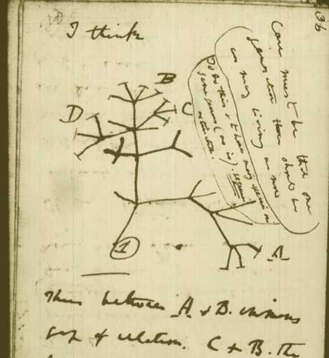
He arrived back in England on the 2nd of October 1936. Immediately he returned to Cambridge to begin examining the specimens that he had sent back during his trip. He had also made over 300 sketches and 1000 notes!

Slide 18
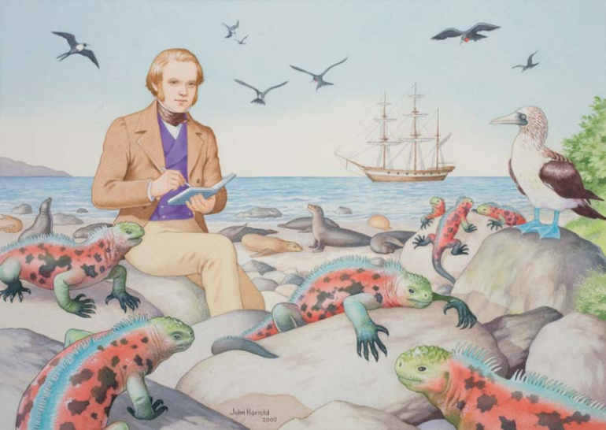
He made over 300 sketches and 1000 notes!

Slide 19
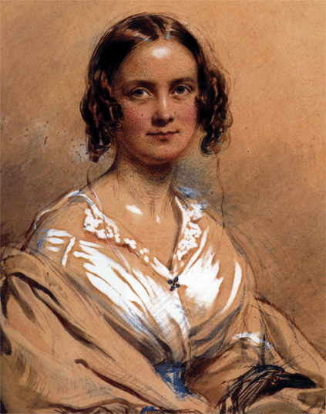
Aged 28 he began to think about settling down and married his first cousin, Emma Wedgwood on the 29th January 1839.

Slide 20
They had 10 children altogether however three unfortunately died during childhood. Their eldest child was William (who was born on the 27th December 1839), followed by Anne, Mary, Henrietta, George, Elizabeth, Francis, Leonard, Horace and Charles.

Slide 21
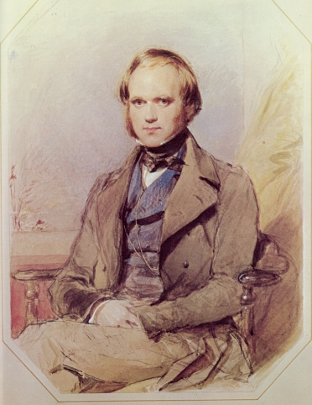
Darwin in 1840.

Slide 22
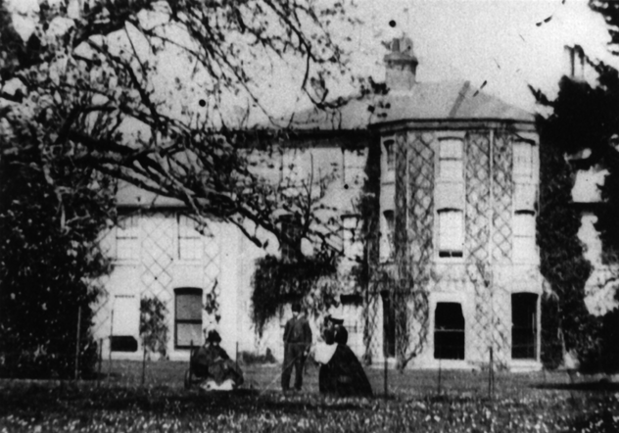
In 1842 they moved to Downe, Kent.

Slide 23
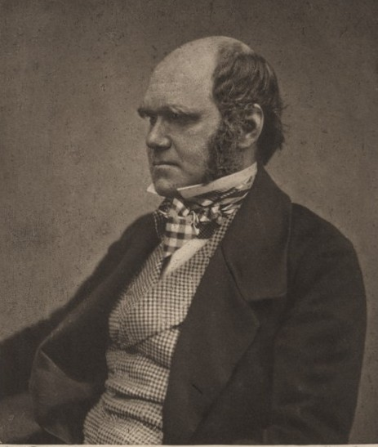
Darwin in 1854.

Slide 24
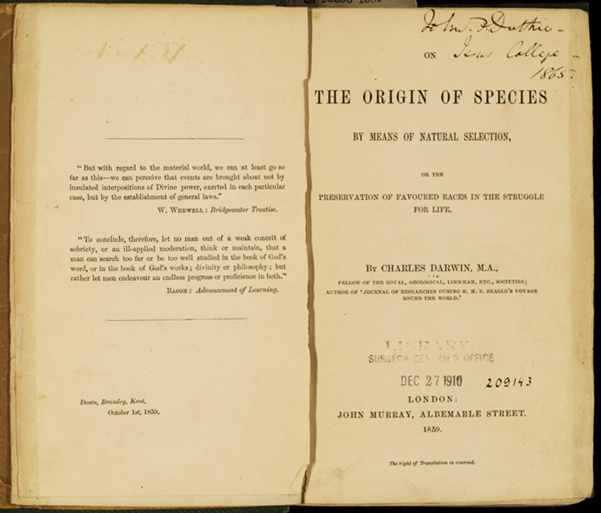
In 1859 he wrote a book called ‘The Origin of Species’ which explained his findings. It challenged the creation story found in the Bible and received a mixed reaction. However, it made his famous and he received many awards and prizes.

Slide 25
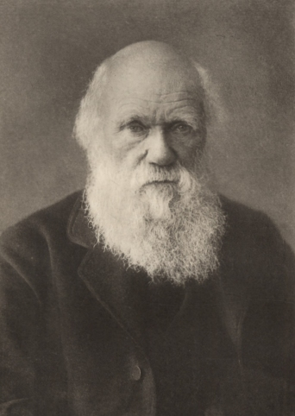
Darwin in 1880.

Slide 26
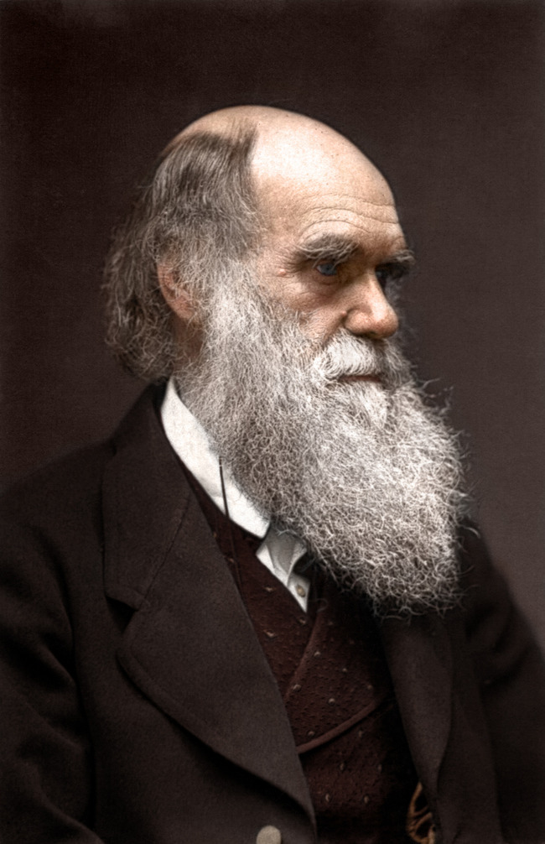
As he became older he become more ill and was often sick; perhaps he was bitten by a nasty bug during his travel – however no one knows for sure. He later died on the 19th April 1882 – aged 72. He was buried at Westminster Abbey and people came from around the world to attend his funeral.

Slide 27
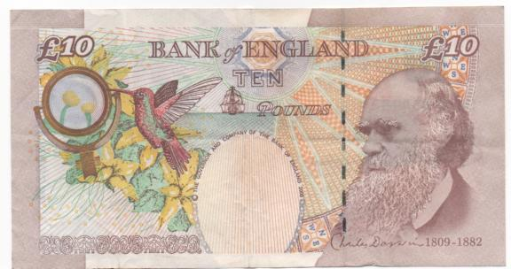
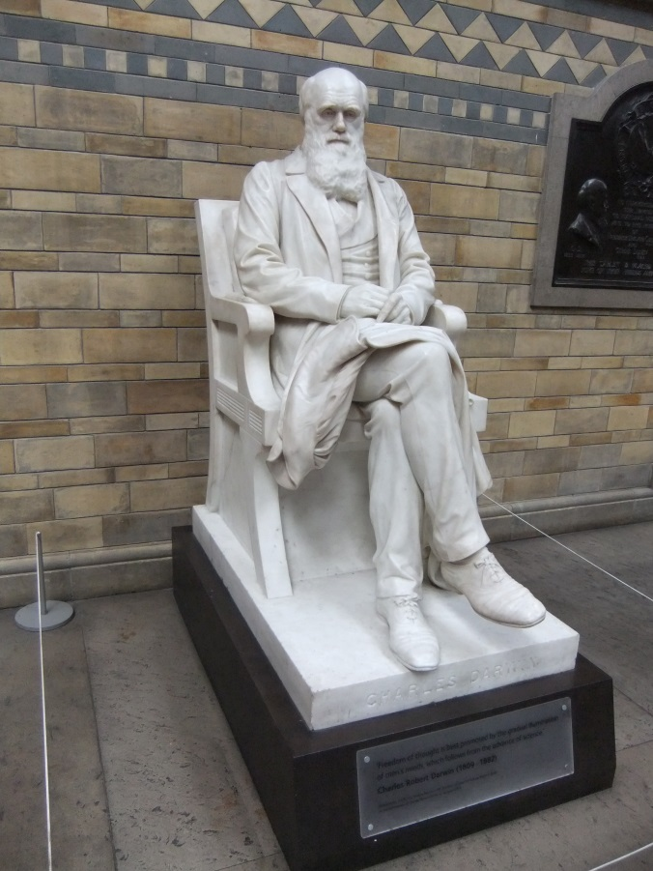
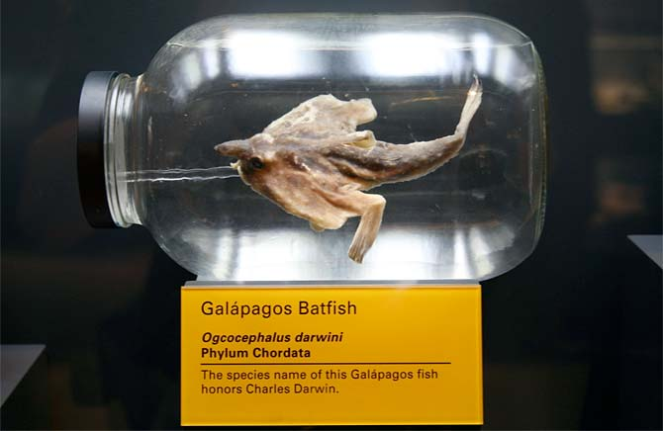
His face is on the UK £10 note and there is a statue of him in London’s Natural History Museum. More than 120 species have been named after him.

