Slide 1
Year 5 – Morning Starter Retrieval Practice

Slide 2
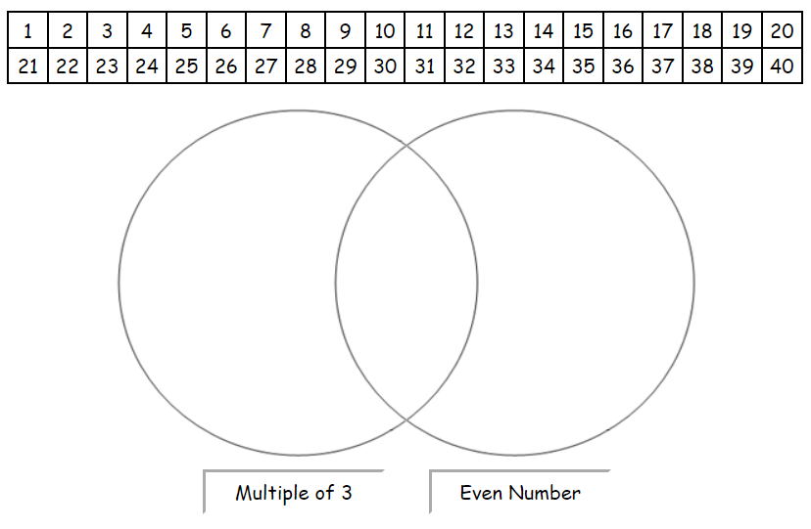
Wednesday 8th January 2024
Geography:
Complete the table below with the following countries and capitals
Havana | USA | Ottowa | San Jose | Mexico
Country | Capital
Canada
 | Washington DC
Cuba
 | Mexico City
Costa Rica
What is the longest river in the UK?
Volga River
Condensation involves a change of state from ___ to ______
What is the longest river in Europe?
River Severn
Evaporation involves a change of state from ______ to ___
What is the longest river in the world?
River Nile

Slide 3
Wednesday 8th January 2024
Geography:
Complete the table below with the following countries and capitals
Havana | USA | Ottowa | San Jose | Mexico
Country | Capital
Canada | Ottowa
USA | Washington DC
Cuba | Havana
Mexico | Mexico City
Costa Rica | San Jose
What is the longest river in the UK?
Volga River
Condensation involves a change of state from GAS to LIQUID
What is the longest river in Europe?
River Severn
Evaporation involves a change of state from LIQUID to GAS
What is the longest river in the world?
River Nile

