Slide 2
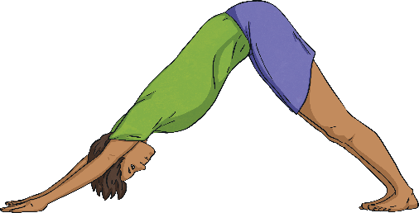
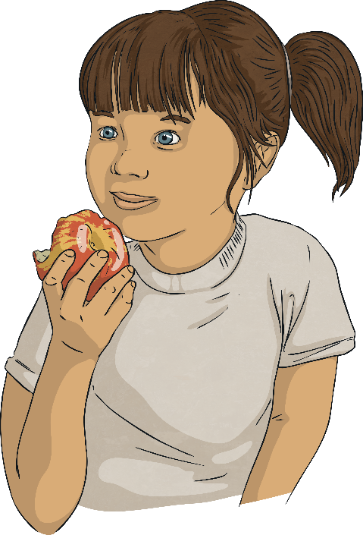
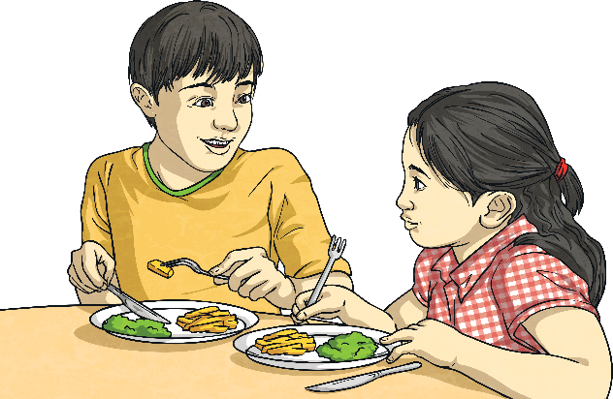
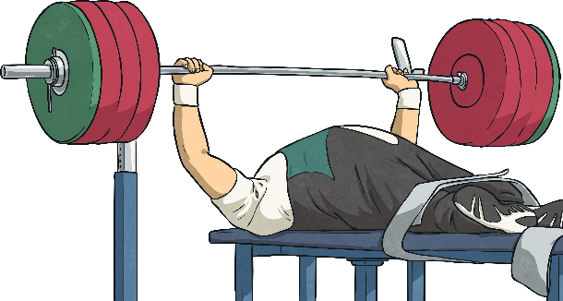
Living Things and Food
Why do living things need food?
To grow
To be strong
To be healthy

Slide 3
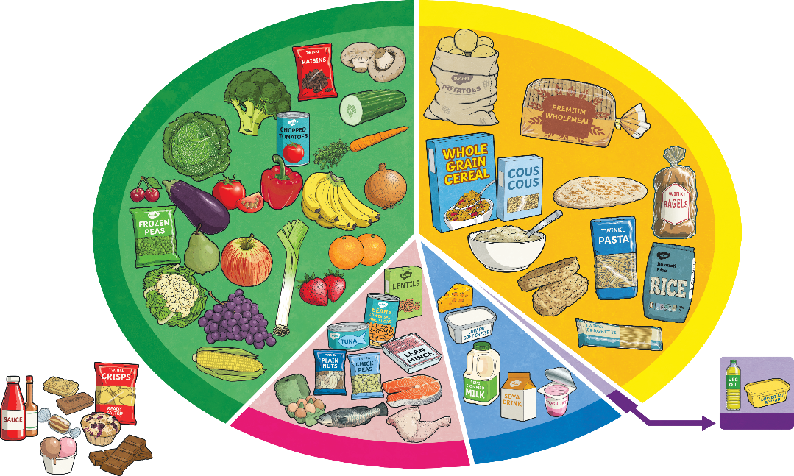
Human Food
What kind of foods do humans need?
Food is commonly divided into five food groups.
How many of the food groups can you remember?
As a group label the food groups.

Slide 4
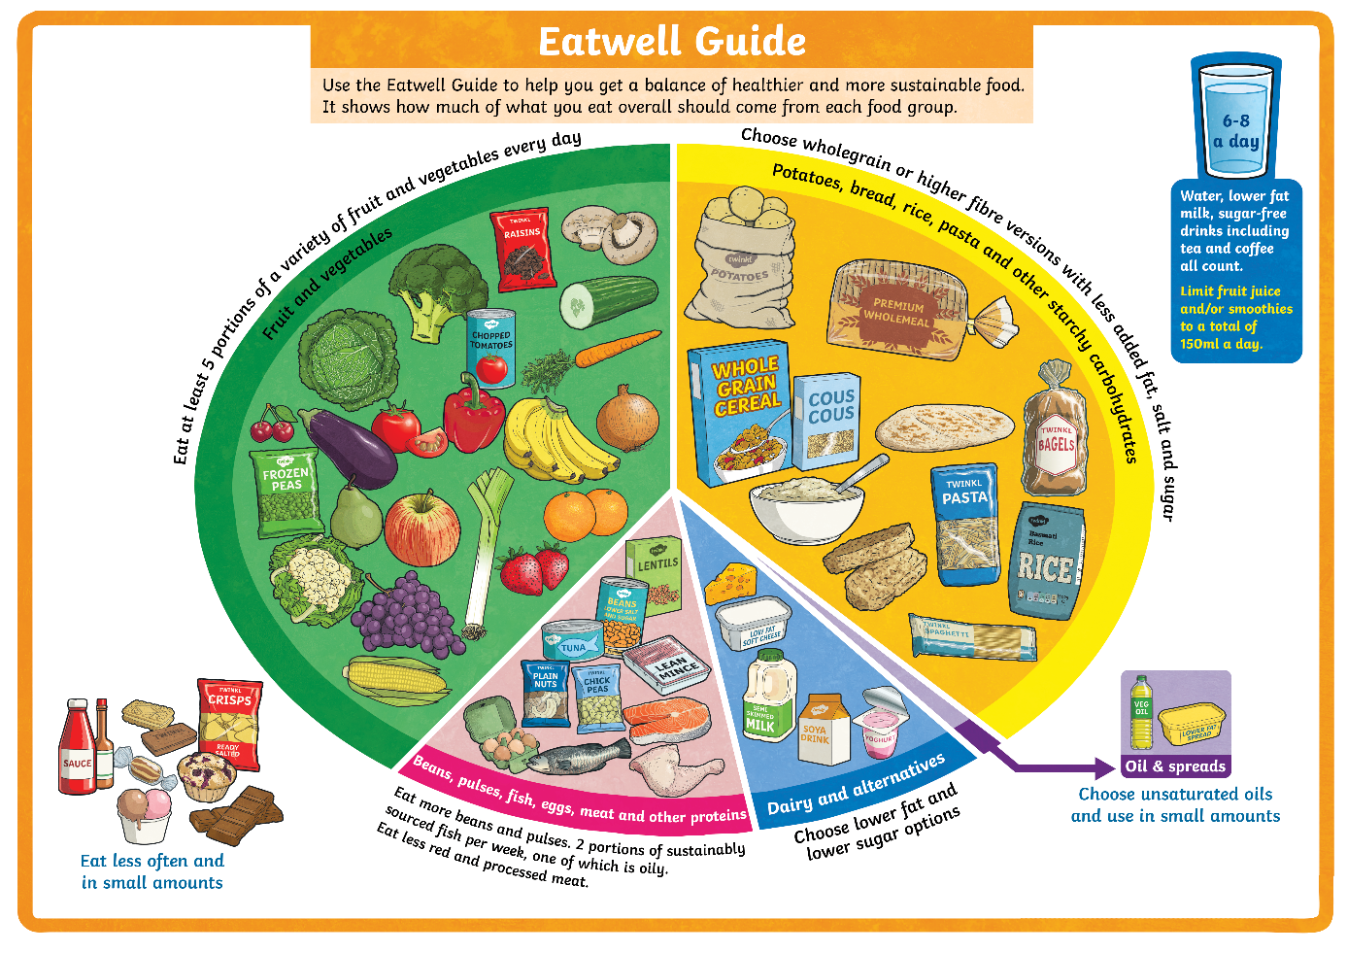
Food Groups
The Eatwell Guide helps us to make decisions about how to make sure we eat the right balance of nutrients in our diets.
The food groups are shown on the Eatwell Guide.
Notice that drinking plenty of water is also very important to keep us healthy.

Slide 5
Types of Nutrients
Nutrients are substances that animals need to stay alive and stay healthy. These nutrients are found in the foods we eat.
There are seven nutrients.

Slide 6
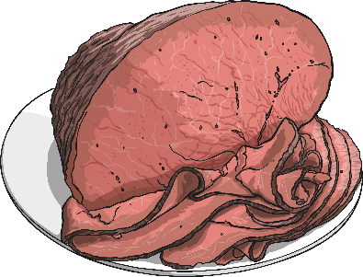
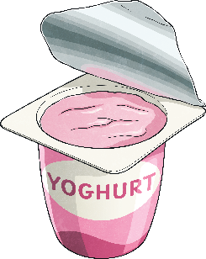
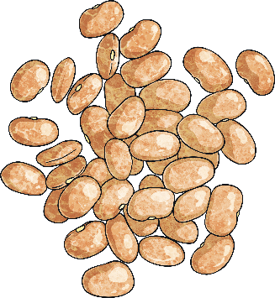
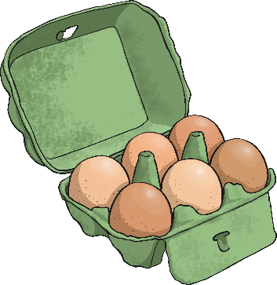
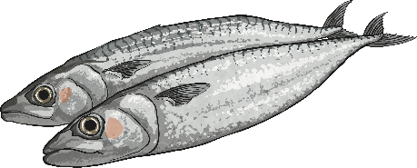
Types of Nutrients - Proteins
Proteins help your body to grow and repair itself.
Foods high in protein include:
Red Meat
Fish
Beans
Yoghurt

Slide 7
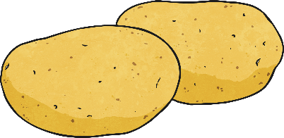
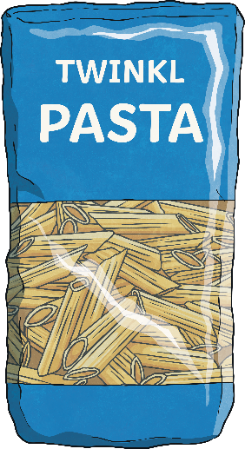
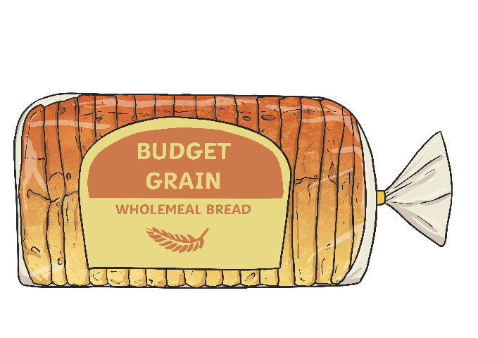
Types of Nutrients - Carbohydrates
Carbohydrates give you energy.
Foods high in carbohydrates include:
Bread
Pasta
Fruit
Potatoes

Slide 8
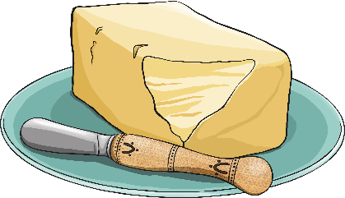
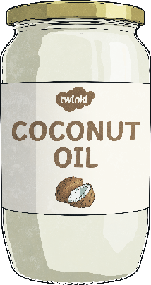
Types of Nutrients - Fats
Fats give you energy.
Foods high in fats include:
Nuts
Oils
Avocados
Butter

Slide 9
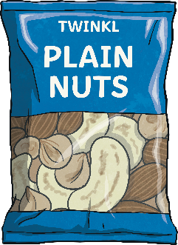
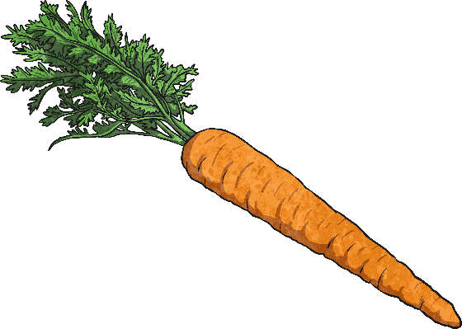
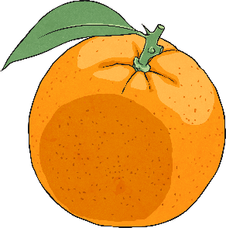
Types of Nutrients - Vitamins
Vitamins keep your body healthy.
Foods high in vitamins include:
Oranges
Carrots
Beef
Nuts

Slide 10
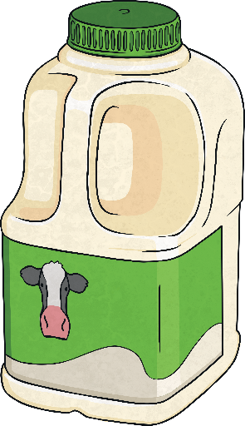
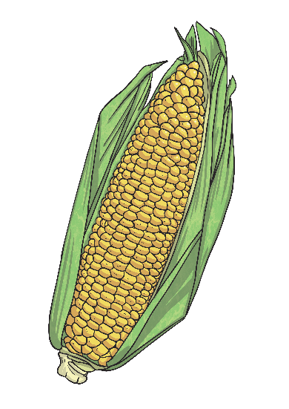
Types of Nutrients - Minerals
Minerals keep your body healthy.
Foods high in minerals include:
Milk
Spinach
Salt
Sweetcorn

Slide 11
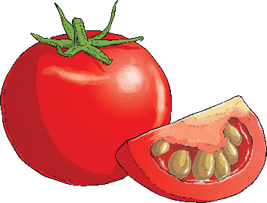
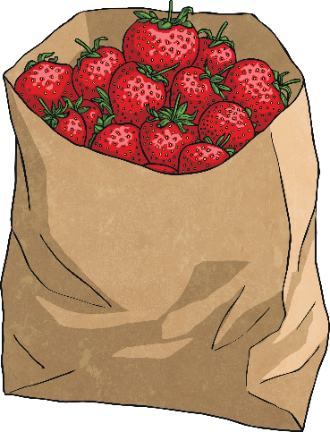
Types of Nutrients - Water
Water helps to move nutrients in your body and get rid of waste that you don’t need. It is an essential nutrient for our survival. While it is really important to drink plenty of water, it is also important to remember that many foods contain water also.
Foods high in water include:
Tomatoes
Cucumbers
Lettuce
Strawberries

Slide 12
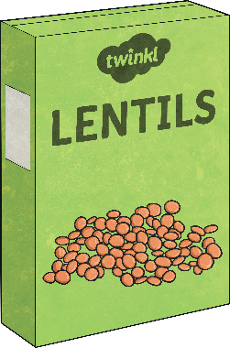
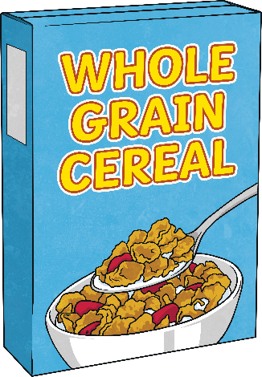
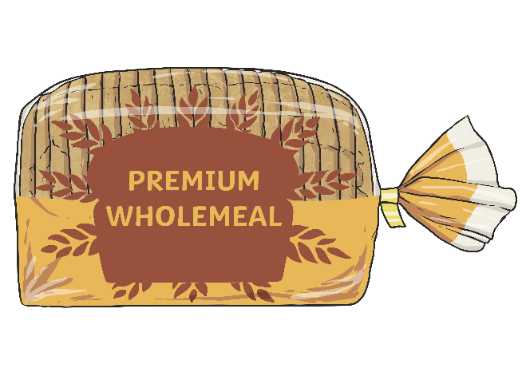
Types of Nutrients - Fibre
Fibre helps you to digest the food that you have eaten.
Foods high in fibre include:
Cereal
Apples
Wholegrain bread
Lentils

Slide 13
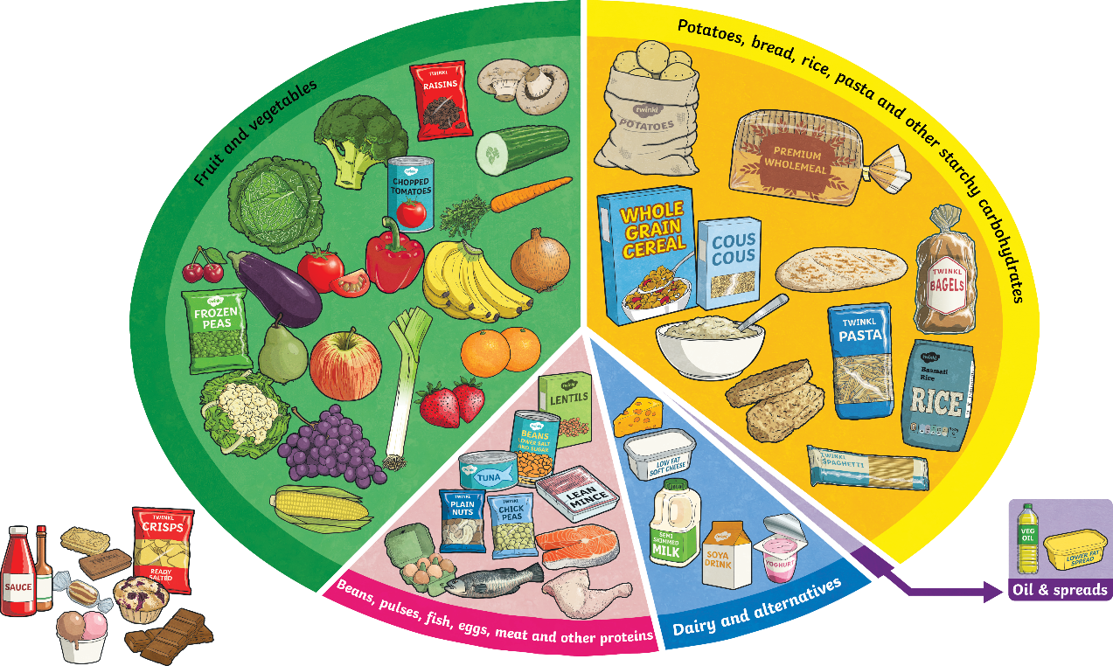
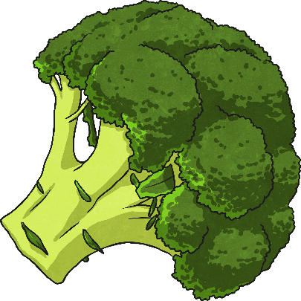
Food Groups and Nutrients
Within each food group, there are many foods which contain more than one type of nutrient.
For example, eating broccoli from the fruit and vegetables section would provide with various different nutrients. This food is a great source of minerals (especially a mineral called potassium), a really good source of vitamins and it provides the body with fibre.

