Slide 1
Spelling week 3 Spring 2
Sound of the week: Phoneme:/ü/

Slide 2
Monday – Sound of the week: Phoneme: /ü/ Written: Grapheme – oo, o, ough, ou and ui Sort the words into the different groups
oo | o | ough | ou
ui

Slide 3
This weeks words: loose through whose group fruit cruise youth lose Statutory words (Y3/4) February believe

Slide 4
Tuesday - Spellings: partner test
1) Using words from yesterday, each pair are going to test each other.
2) Please gather spelling lists from the front.
3) Once you have tested each other, mark each other’s spellings and see which spellings you have got incorrect.
4) Highlight the part of the spelling you are getting incorrect, focus on our sounds for this week.
5) Write down 5 words you need to practise to spell this week.

Slide 5
Wednesday - Spelling: sound analysis (sound buttons)
Can you identify the individual phonemes in each word?
loose
cruise
Complete in your spelling books with each of the spellings for this week

Slide 6
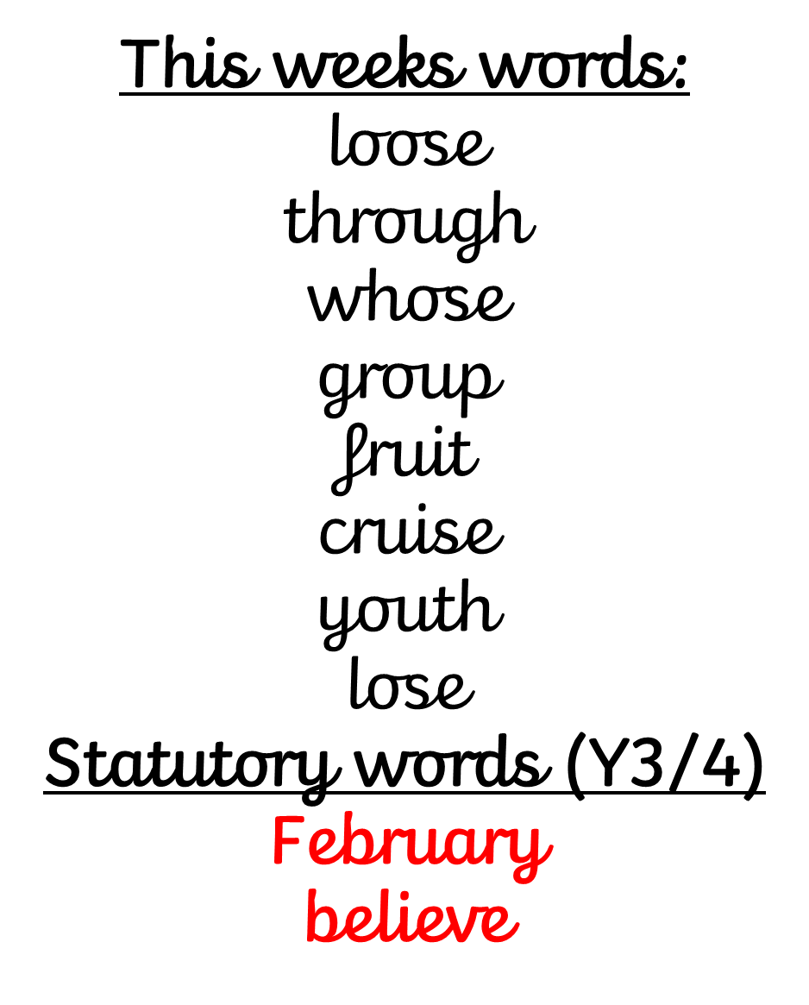
Thursday - Sound of the week: Phoneme: /ü/ Written: Grapheme – oo, o, ough, ou and ui Copy the words into your handwriting books – neatly and correctly – underline your sounds in your spelling words

Slide 7
This weeks words: loose through whose group fruit cruise youth lose Statutory words (Y3/4) February believe

Slide 8
Friday - Spellings: Test: Adult led
I will read aloud each spelling with our phoneme of the week and our statutory words.
1 point for the phoneme spelt correctly – oo, o, ough, ou and ui
2 points for the whole word spelt correctly.

Slide 9
Friday - Spellings: Test: Adult led
I will read aloud each spelling with our phoneme of the week and our statutory words.
1 point for the phoneme spelt correctly – oo, o, ough, ou and ui
2 points for the whole word spelt correctly.

