Slide 1
Spelling week 2 Spring 2
Sound of the week: Phoneme:/û/

Slide 2
Monday – Sound of the week: Phoneme: / û / Written: Grapheme – er, ear, ar,our Sort the words into the different groups
er | ear | ar | our

Slide 3
This weeks words: weather whether grammar learn perhaps calendar popular journey Statutory words (Y3/4) favourite heard

Slide 4
Tuesday - Spellings: partner test
1) Using words from yesterday, each pair are going to test each other.
2) Please gather spelling lists from the front.
3) Once you have tested each other, mark each other’s spellings and see which spellings you have got incorrect.
4) Highlight the part of the spelling you are getting incorrect, focus on our sounds for this week.
5) Write down 5 words you need to practise to spell this week.

Slide 5
Wednesday - Spelling: sound analysis (sound buttons)
Can you identify the individual phonemes in each word?
Weather
journey
Complete in your spelling books with each of the spellings for this week

Slide 6
Thursday - Sound of the week: Phoneme: / û / Written: Grapheme – er, ear, ar,our Copy the words into your handwriting books – neatly and correctly – underline your sounds in your spelling words
This weeks words: weather whether grammar learn perhaps calendar popular journey Statutory words (Y3/4) favourite heard

Slide 7
This weeks words: weather whether grammar learn perhaps calendar popular journey Statutory words (Y3/4) favourite heard

Slide 8
Friday - Spellings: Test: Adult led
I will read aloud each spelling with our phoneme of the week and our statutory words.
1 point for the phoneme spelt correctly – er, ear, ar, our
2 points for the whole word spelt correctly.

Slide 9
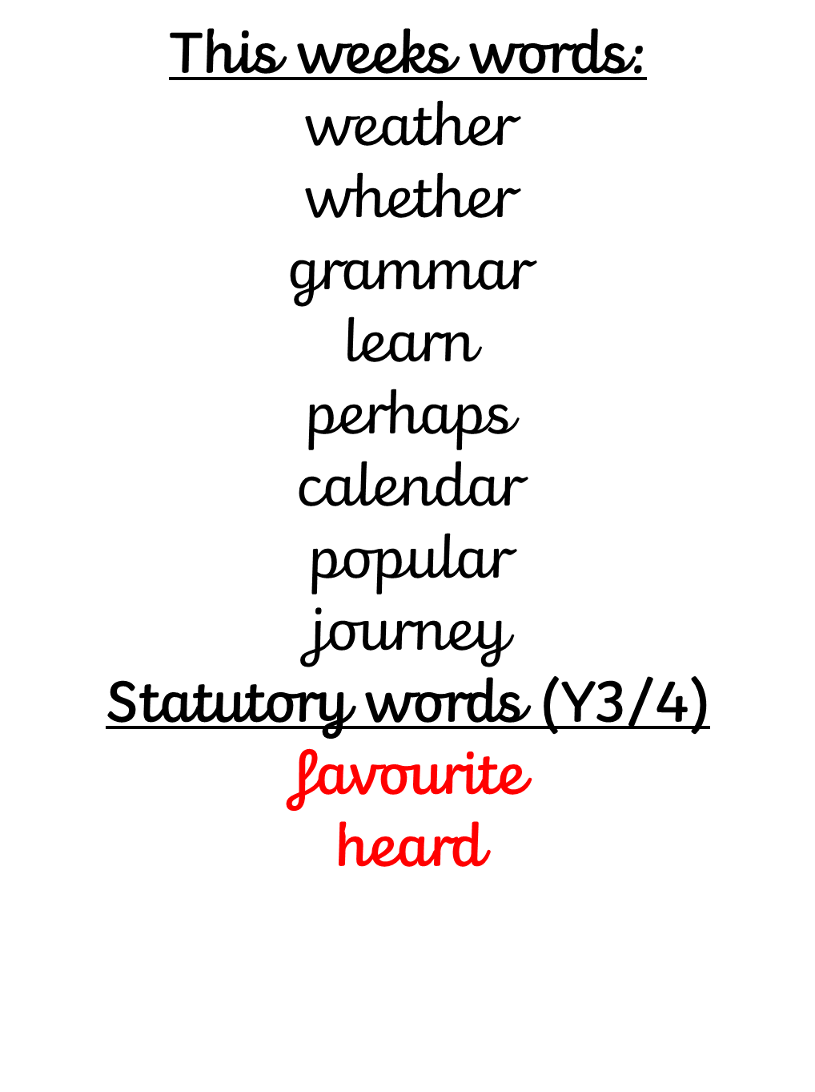
Friday - Spellings: Test: Adult led
I will read aloud each spelling with our phoneme of the week and our statutory words.
1 point for the phoneme spelt correctly – er, ear, ar, our
2 points for the whole word spelt correctly.

Slide 10
er | ear | ar | our
er | ear | ar | our
er | ear | ar | our
er | ear | ar | our

